Slide 1
Mammal Phylogeny
Tuesday, March 29th

Slide 2
Part I – Identifying Structure and Function
Observe different structures of mammal skulls
Propose claims about the life history of 4 species based on skull structure

Slide 3
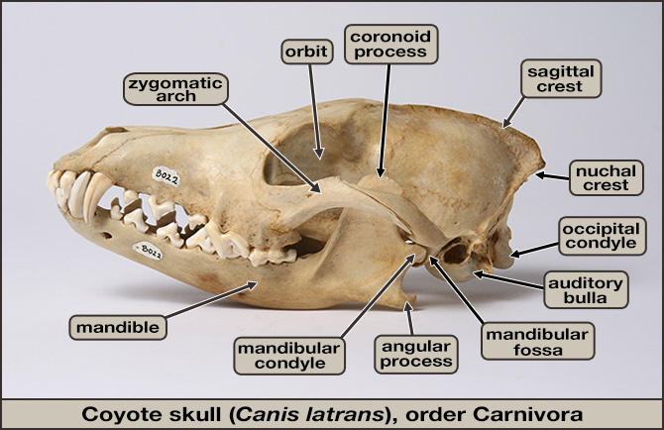
Notes:
“mandible” = lower jaw
“orbit” = eye socket
“fossa” = depression or hole
“process” = outward projection
“condyle” = a knob such as the ball of a ball and socket joint

Slide 4
Terms
“mandible” = lower jaw
“orbit” = eye socket
“fossa” = depression or hole
“process” = outward projection
“condyle” = a knob such as the ball of a ball and socket joint

Slide 5
Important muscles
Notes:
These are two important muscles for eating and are connected via skull structure/projections
Temporalis is used forbiting and can be felt when chewing above ears
Masseter is used for lateral jaw movements (grinding) and can be felt at the back of your jaw when you grit your teet
So, which species should have a large temporalis and why? A carnivore as they have to bite down into their prey
What about a large masseter? Herbivores as they have to grind vegetation

Slide 6
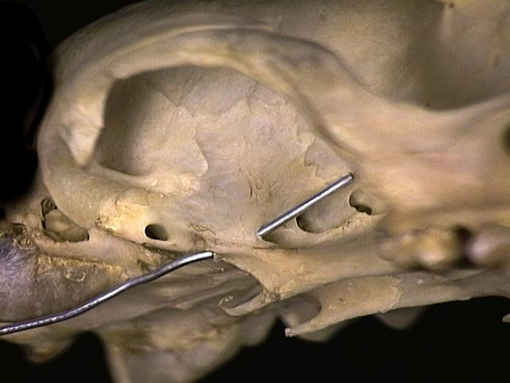
Blood vessels
Skulls need depressions, channels, and canals for arteries and veins to allow for blood flow
Alisphenoid canal found in some animals underneath upper jaw
Notes:
DON’T FORCE THE WIRE!!!!
Only canids will have it

Slide 7
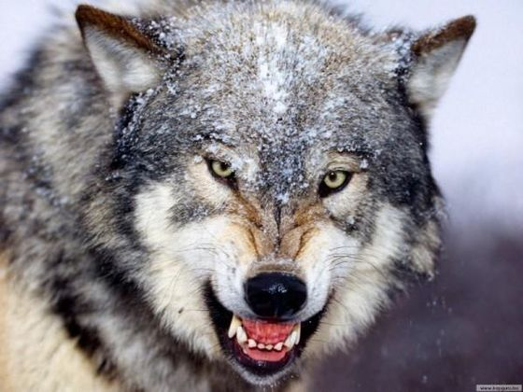
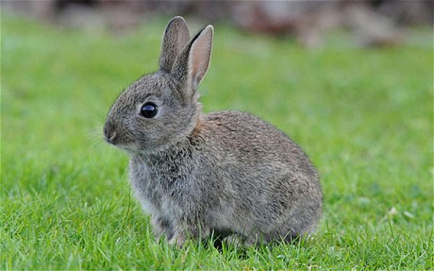
Eyes
Eye orientation
Predators have forward-facing eyes
Prey have side-facing eyes
Eye size
Nocturnal species have larger eyes
Noct

Slide 8
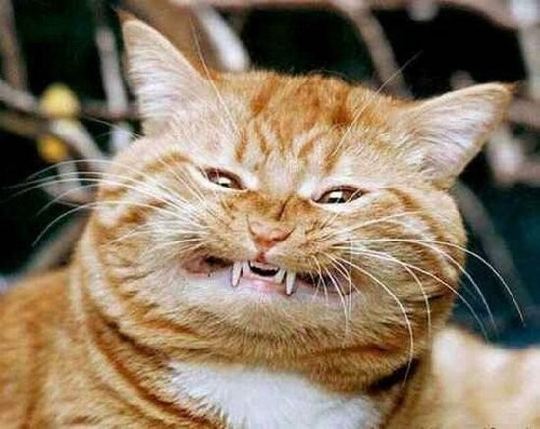
Teeth
The lifestyles of mammals require being able to capture, ingest, and digest food efficiently
Mammalian teeth have been modified to obtain and ingest food more efficiently

Slide 9
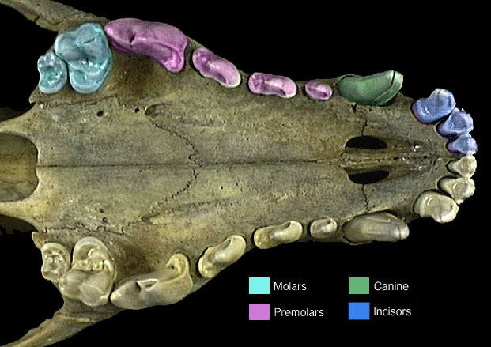
Types of Teeth
Incisors
Canines
Premolars
Molars

Slide 10
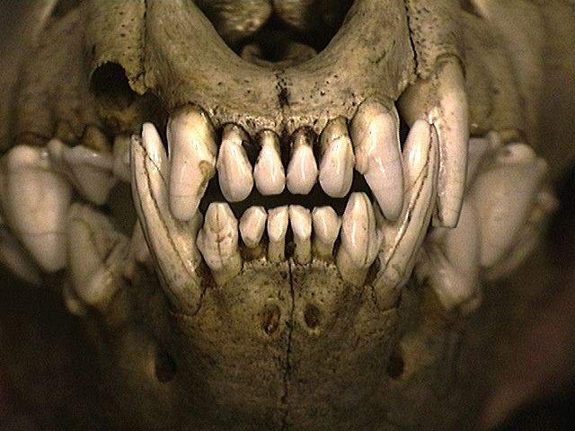
Incisors
Thin teeth located at the front of the jaw
Used for slicing food

Slide 11
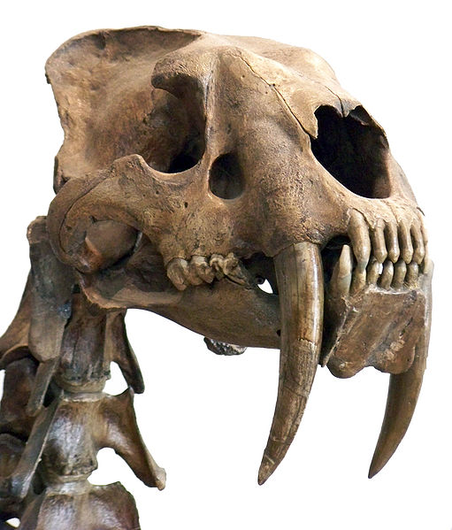
Canines
Located right next to the incisors (if they have them!)
Used for tearing food

Slide 12
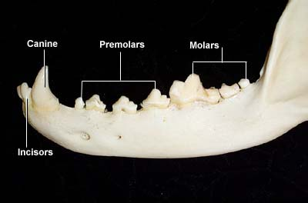
Premolars and Molars
Located behind canines
Used for chewing, generally with multiple cusps (points)
Only adults have molars!
Eutherians (placental mammals) have maximum of 4 premolars and 3 molars
Metatherians (marsupials)have a maximum of 3 premolars and 4 molars
Notes:
***These can be difficult to distinguish which is why it is useful to know that eutharians have a maximum of 3 molars.

Slide 13
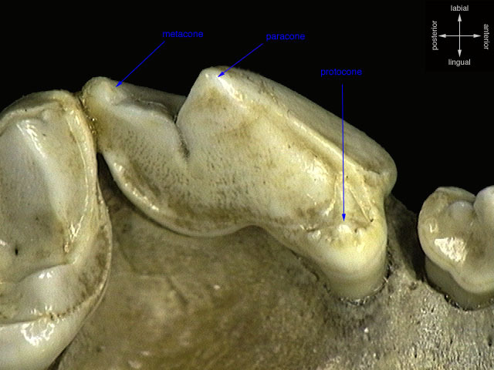
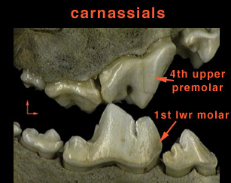
Carnassials
Order Carnivora have these
Specialized teeth which slide together to slice meat
P⁴ and M₁ = carnassial pair, overlap

Slide 14
Note
These skulls are fragile and expensive! Try not to handle them any more than you have to. When you do pick them up, do so over a padded surface so in case they are accidentally dropped they will be less likely to break.

